Slide 1
Chapter 9 - Formatted Input/Output
Outline
9.1 Introduction
9.2 Streams
9.3 Formatting Output with printf
9.4 Printing Integers
9.5 Printing Floating-Point Numbers
9.6 Printing Strings and Characters
9.7 Other Conversion Specifiers
9.8 Printing with Field Widths and Precisions
9.9 Using Flags in the printf Format-Control String
9.10 Printing Literals and Escape Sequences
9.11 Formatting Input with scanf

Slide 2
Objectives
In this chapter, you will learn:
  To understand input and output streams.
  To be able to use all print formatting capabilities.
  To be able to use all input formatting capabilities.

Slide 3
9.1 Introduction
In this chapter
  Presentation of results
  scanf and printf
  Streams (input and output)
    gets, puts, getchar, putchar (in <stdio.h>)

Slide 4
9.2 Streams
Streams
  Sequences of characters organized into lines
    Each line consists of zero or more characters and ends with newline character
    ANSI C must support lines of at least 254 characters
  Performs all input and output
  Can often be redirected
    Standard input – keyboard
    Standard output – screen
    Standard error – screen
    More in Chapter 11

Slide 5
9.3 Formatting Output with printf
printf
  Precise output formatting
    Conversion specifications: flags, field widths, precisions, etc.
  Can perform rounding, aligning columns, right/left justification, inserting literal characters, exponential format, hexadecimal format, and fixed width and precision
Format
  printf( format-control-string, other-arguments );
  Format control string: describes output format
  Other-arguments: correspond to each conversion specification in format-control-string
    Each specification begins with a percent sign(%), ends with conversion specifier

Slide 6
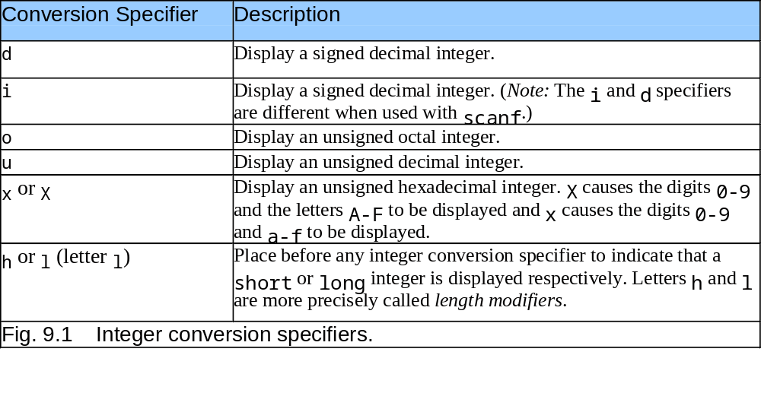
9.4 Printing Integers

Slide 7
9.4 Printing Integers
Integer
  Whole number (no decimal point): 25, 0, -9
  Positive, negative, or zero
  Only minus sign prints by default (later we shall change this)

Slide 8
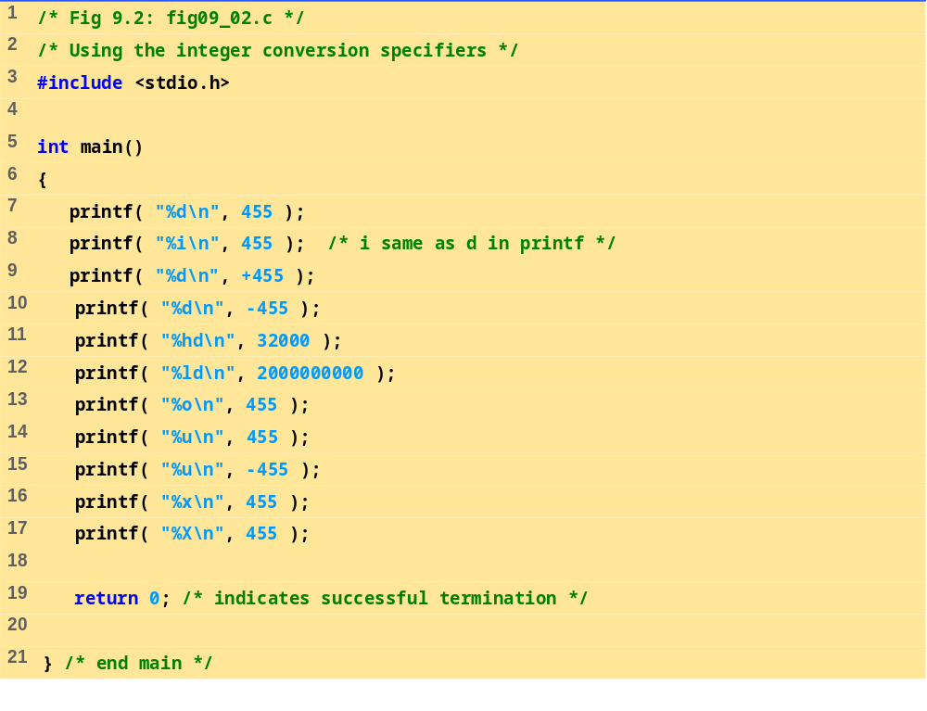
fig09_02.c

Slide 9
455
455
455
-455
32000
2000000000
707
455
4294966841
1c7
1C7
Program Ouptut

Slide 10
9.5 Printing Floating-Point Numbers
Floating Point Numbers
  Have a decimal point (33.5)
  Exponential notation (computer's version of scientific notation)
    150.3 is 1.503 x 10² in scientific
    150.3 is 1.503E+02 in exponential (E stands for exponent)
    use e or E
  f – print floating point with at least one digit to left of decimal
  g (or G) - prints in f or e with no trailing zeros (1.2300 becomes 1.23)
    Use exponential if exponent less than -4, or greater than or equal to precision (6 digits by default)

Slide 11
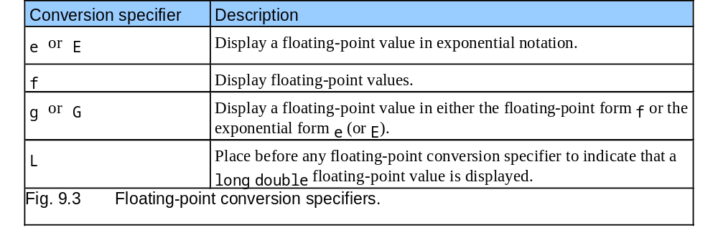
9.5 Printing Floating-Point Numbers

Slide 12
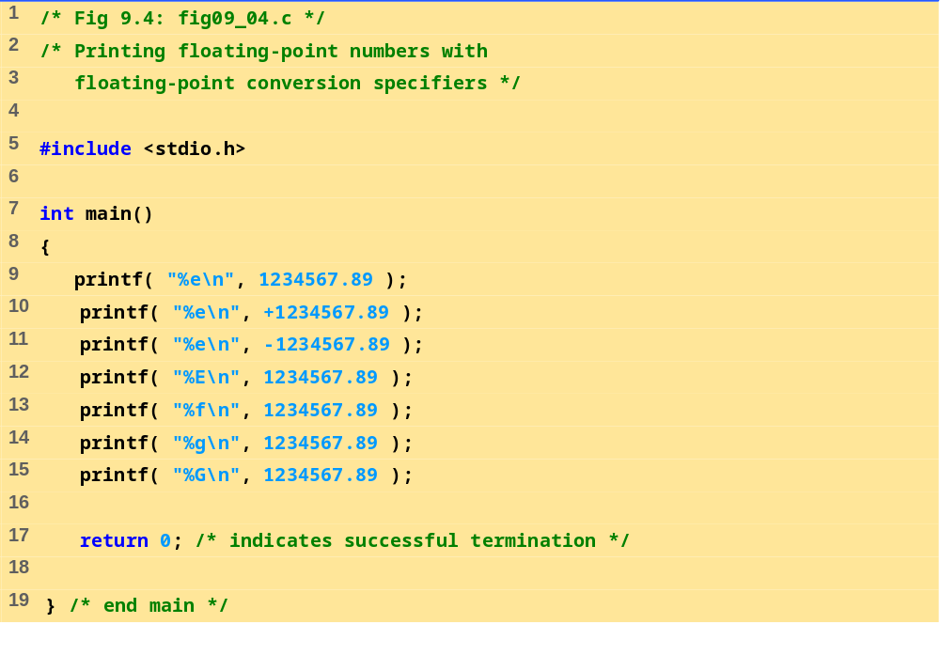
fig09_04.c
Program Output
1.234568e+006
1.234568e+006
-1.234568e+006
1.234568E+006
1234567.890000
1.23457e+006
1.23457E+006

Slide 13
9.6 Printing Strings and Characters
c
  Prints char argument
  Cannot be used to print the first character of a string
s
  Requires a pointer to char as an argument
  Prints characters until NULL ('\0') encountered
  Cannot print a char argument
Remember
  Single quotes for character constants ('z')
  Double quotes for strings "z" (which actually contains two characters, 'z' and '\0')

Slide 14
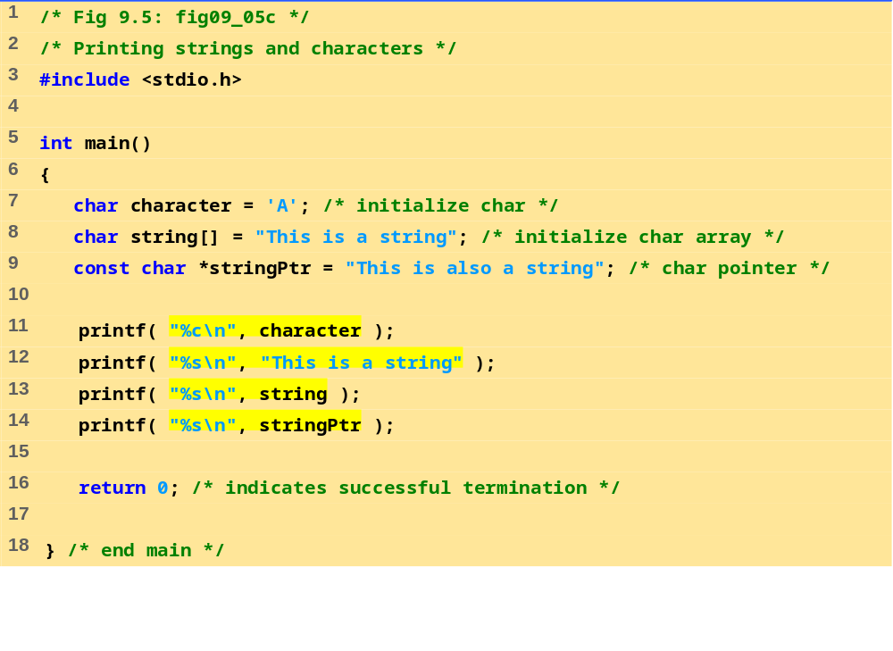
fig09_05.c
A
This is a string
This is a string
This is also a string

Slide 15
9.7 Other Conversion Specifiers
p
  Displays pointer value (address)
n
  Stores number of characters already output by current printf statement
  Takes a pointer to an integer as an argument
  Nothing printed by a %n specification
  Every printf call returns a value
    Number of characters output
    Negative number if error occurs
%
  Prints a percent sign
  %%

Slide 16
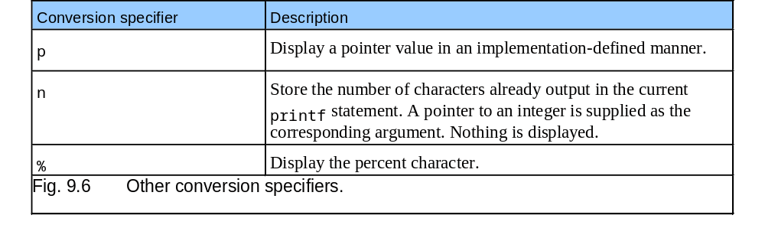
9.7 Other Conversion Specifiers

Slide 17
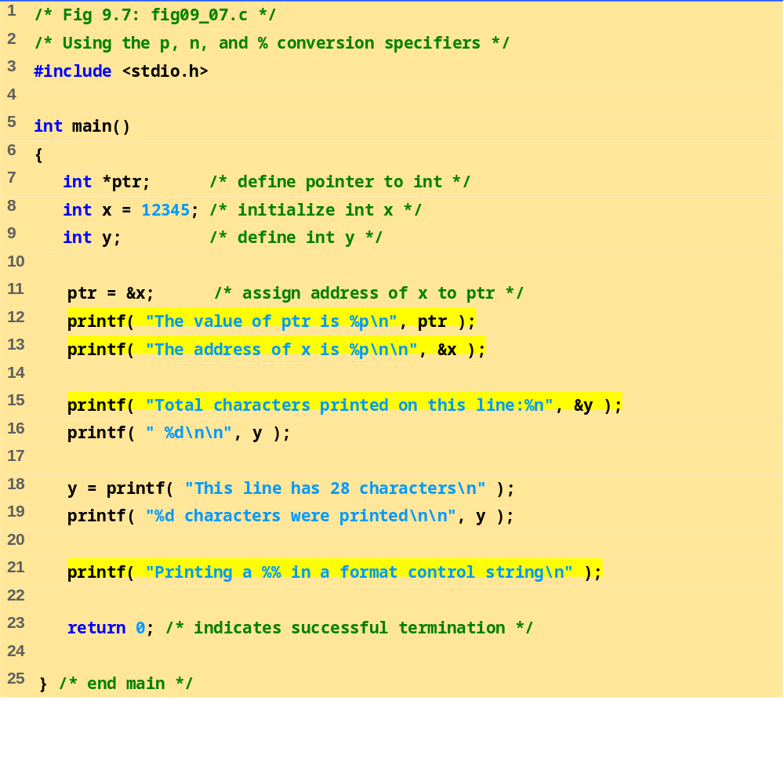
fig09_07.c (1 of 2)

Slide 18
The value of ptr is 0012FF78
The address of x is 0012FF78
Total characters printed on this line: 38
This line has 28 characters
28 characters were printed
Printing a % in a format control string
Program Output

Slide 19
9.8 Printing with Field Widths and Precisions
Field width
  Size of field in which data is printed
  If width larger than data, default right justified
    If field width too small, increases to fit data
    Minus sign uses one character position in field
  Integer width inserted between % and conversion specifier
  %4d – field width of 4

Slide 20
9.8 Printing with Field Widths and Precisions
Precision
  Meaning varies depending on data type
  Integers (default 1)
    Minimum number of digits to print
      If data too small, prefixed with zeros
  Floating point
    Number of digits to appear after decimal (e and f)
      For g – maximum number of significant digits
  Strings
    Maximum number of characters to be written from string
  Format
    Use a dot (.) then precision number after %
      %.3f

Slide 21
9.8 Printing with Field Widths and Precisions
Field width and precision
  Can both be specified
    %width.precision
        %5.3f
  Negative field width – left justified
  Positive field width – right justified
  Precision must be positive
  Can use integer expressions to determine field width and precision values
    Place an asterisk (*) in place of the field width or precision
      Matched to an int argument in argument list
    Example:
      printf( "%*.*f", 7, 2, 98.736 );

Slide 22
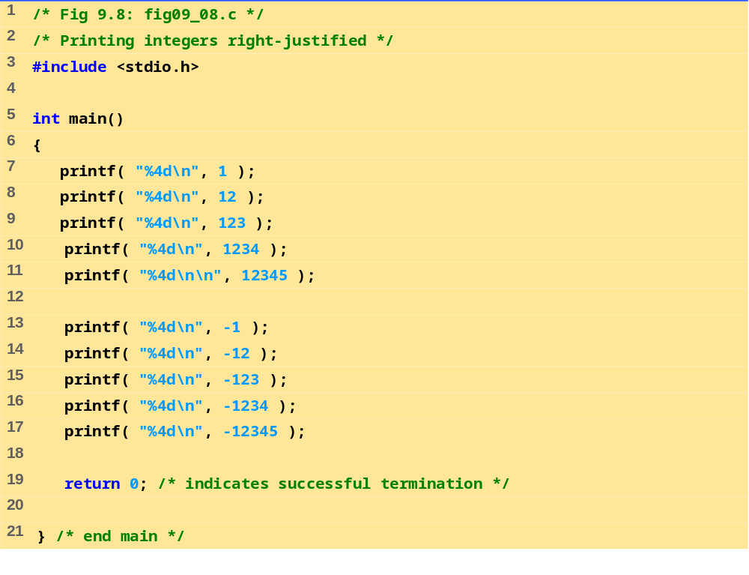
fig09_08.c

Slide 23
1
12
123
1234
12345
-1
-12
-123
-1234
-12345
Program Output

Slide 24
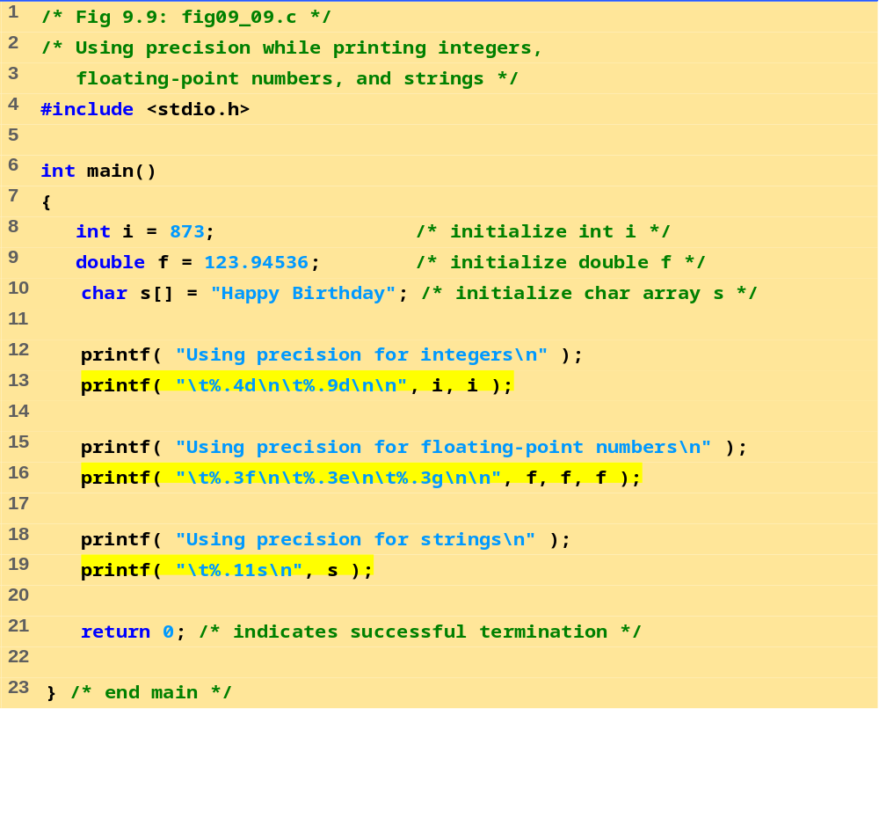
fig09_09.c

Slide 25
Using precision for integers
0873
000000873
Using precision for floating-point numbers
123.945
1.239e+002
124
Using precision for strings
Happy Birth
Program Output

Slide 26
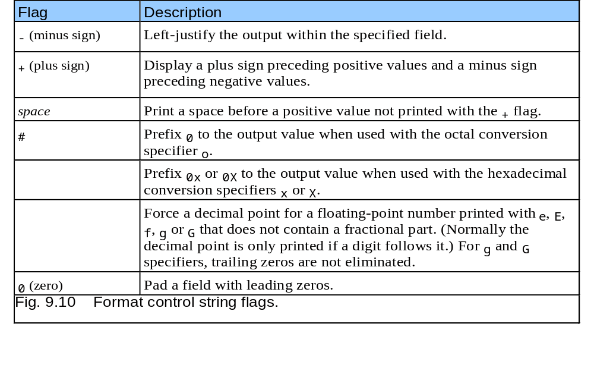
9.9 Using Flags in the printf
Format-Control String
Flags
  Supplement formatting capabilities
  Place flag immediately to the right of percent sign
  Several flags may be combined

Slide 27
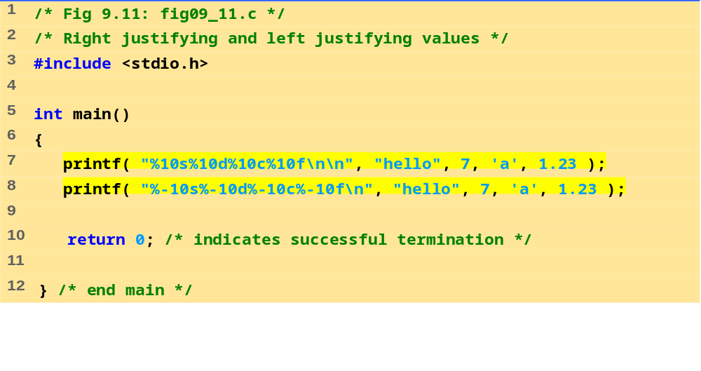
fig09_11.c
Program Output
hello 7 a 1.230000
hello 7 a 1.230000

Slide 28
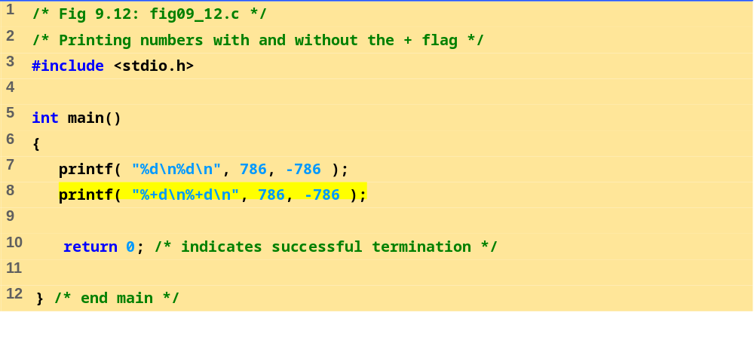
fig09_12.c
Program Output
786
-786
+786
-786

Slide 29
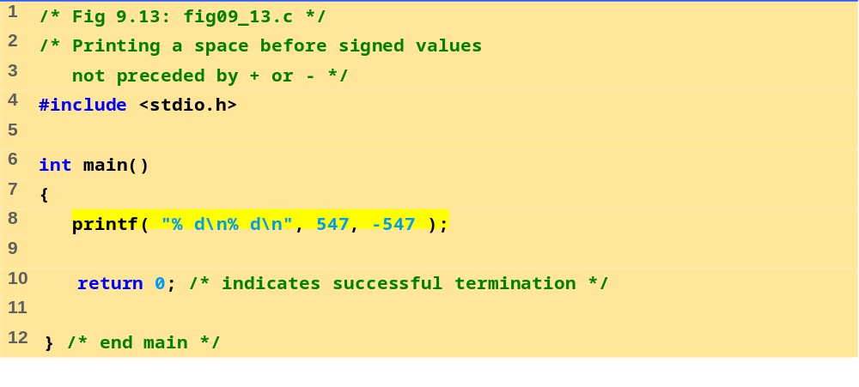
fig09_13.c
Program Output
547
-547

Slide 30
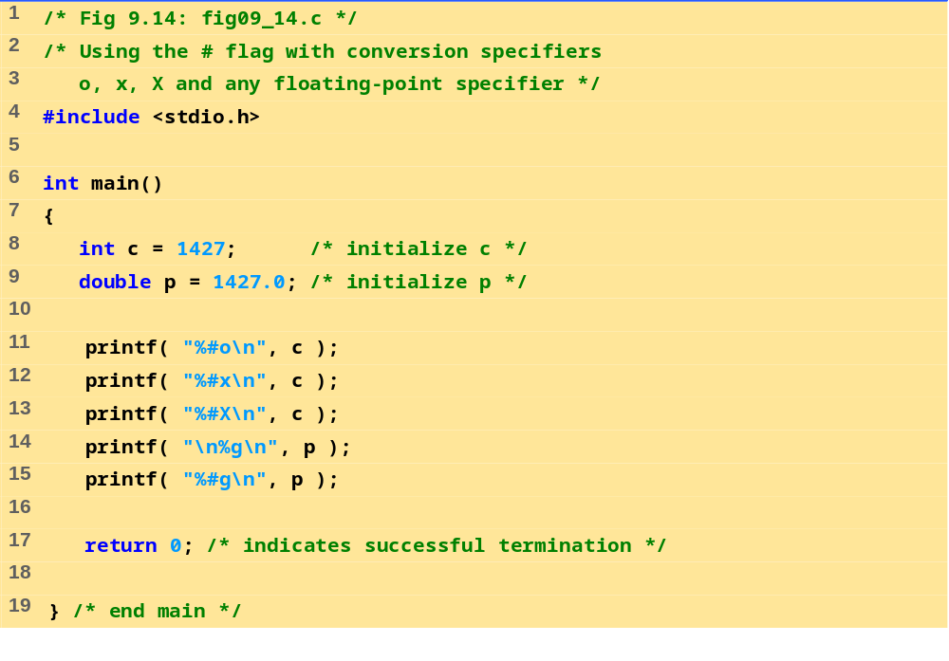
fig09_14.c
Program Output
02623
0x593
0X593
1427
1427.00

Slide 31
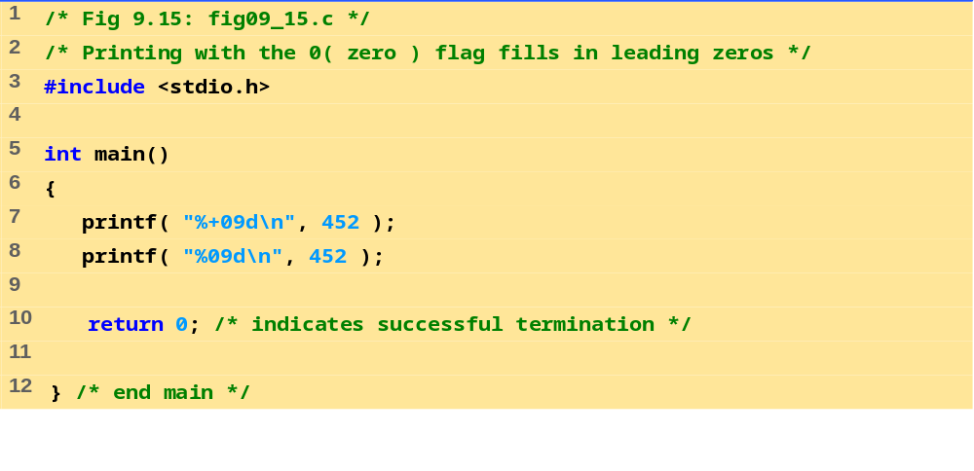
fig09_15.c
Program Output
+00000452
000000452

Slide 32
9.10 Printing Literals and Escape Sequences
Printing Literals
  Most characters can be printed
  Certain "problem" characters, such as the quotation mark "
  Must be represented by escape sequences
    Represented by a backslash \ followed by an escape character

Slide 33
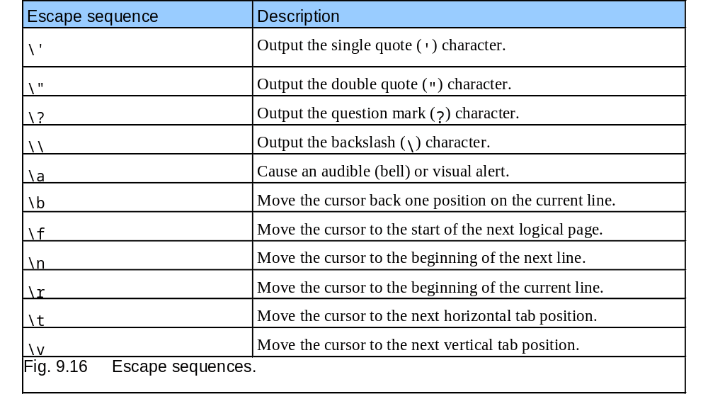
9.10 Printing Literals and Escape Sequences

Slide 34
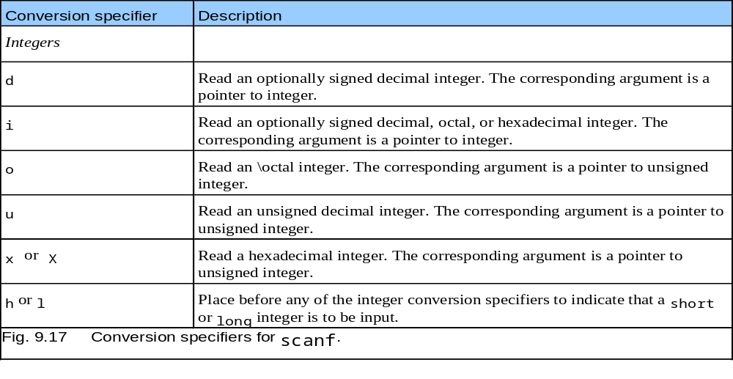
9.11 Formatting Input with scanf

Slide 35
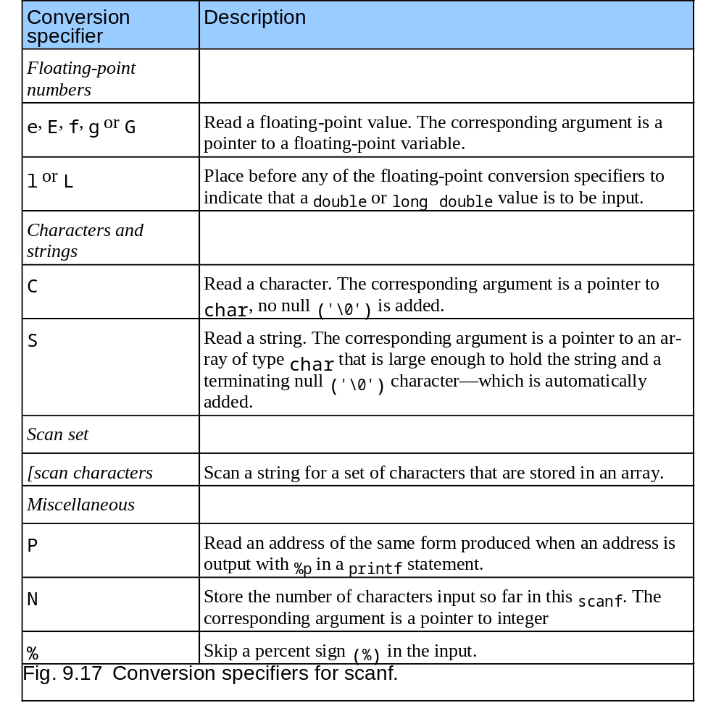
9.11 Formatting Input with scanf

Slide 36
9.11 Formatting Input with scanf
scanf
  Input formatting
  Capabilities
    Input all types of data
    Input specific characters
    Skip specific characters
Format
  scanf(format-control-string, other-arguments);
  Format-control-string
    Describes formats of inputs
  Other-arguments
    Pointers to variables where input will be stored
  Can include field widths to read a specific number of characters from the stream

Slide 37
9.11 Formatting Input with scanf
Scan sets
  Set of characters enclosed in square brackets []
    Preceded by % sign
  Scans input stream, looking only for characters in scan set
    Whenever a match occurs, stores character in specified array
    Stops scanning once a character not in the scan set is found
  Inverted scan sets
    Use a caret ^: [^aeiou]
    Causes characters not in the scan set to be stored
Skipping characters
  Include character to skip in format control
  Or, use * (assignment suppression character)
    Skips any type of character without storing it

Slide 38
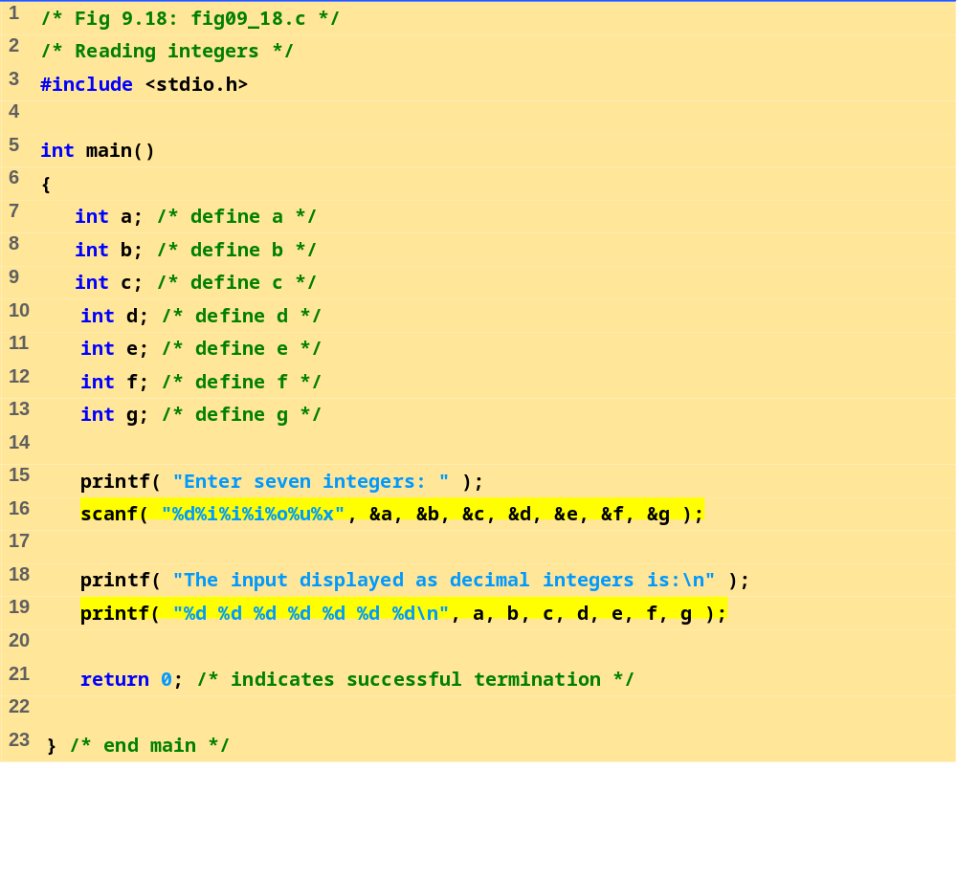
fig09_18.c
Program Output
Enter seven integers: -70 -70 070 0x70 70 70 70
The input displayed as decimal integers is:
-70 -70 56 112 56 70 112

Slide 39
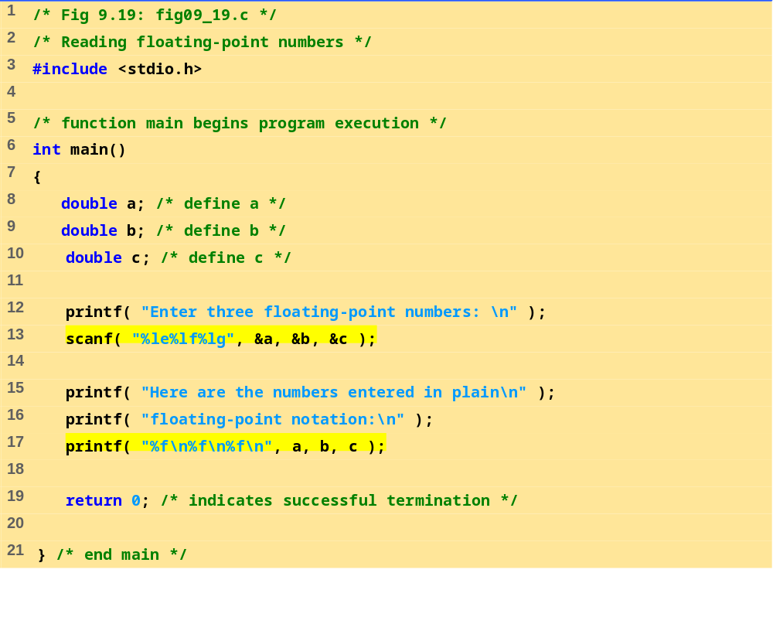
fig09_19.c

Slide 40
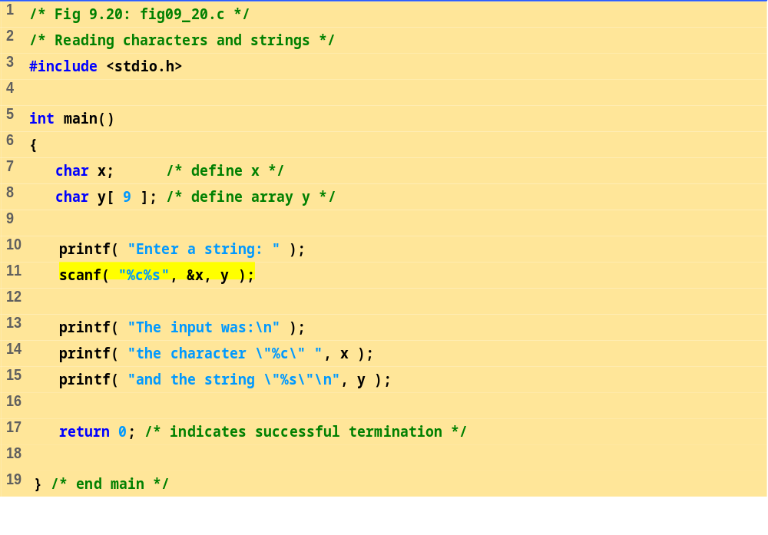
fig09_20.c
Program Output
Enter a string: Sunday
The input was:
the character "S" and the string "unday"

Slide 41
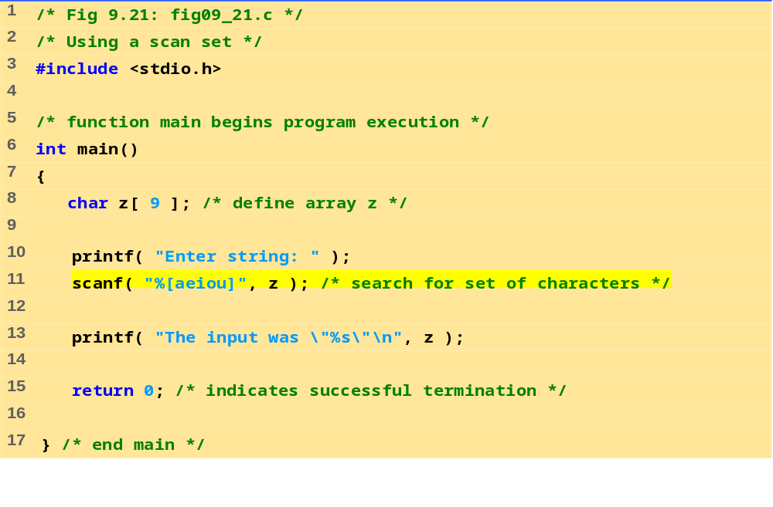
fig09_21.c
Program Output
Enter string: ooeeooahah
The input was "ooeeooa"

Slide 42
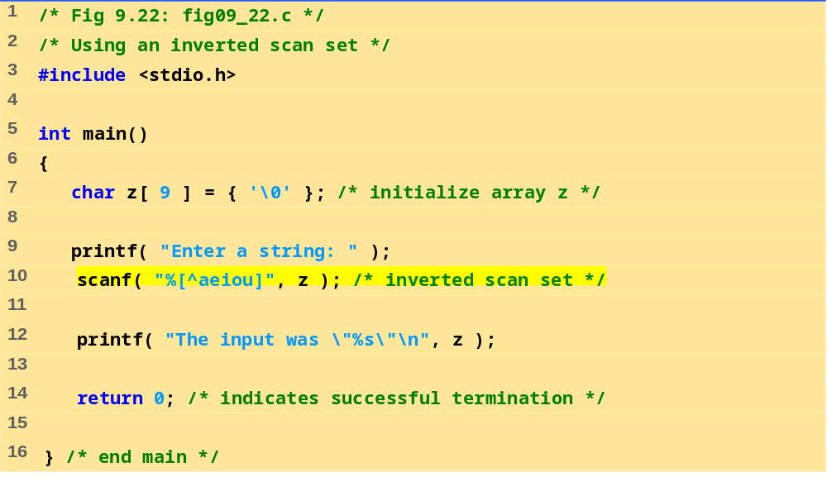
fig09_22.c
Program Output
Enter a string: String
The input was "Str"

Slide 43
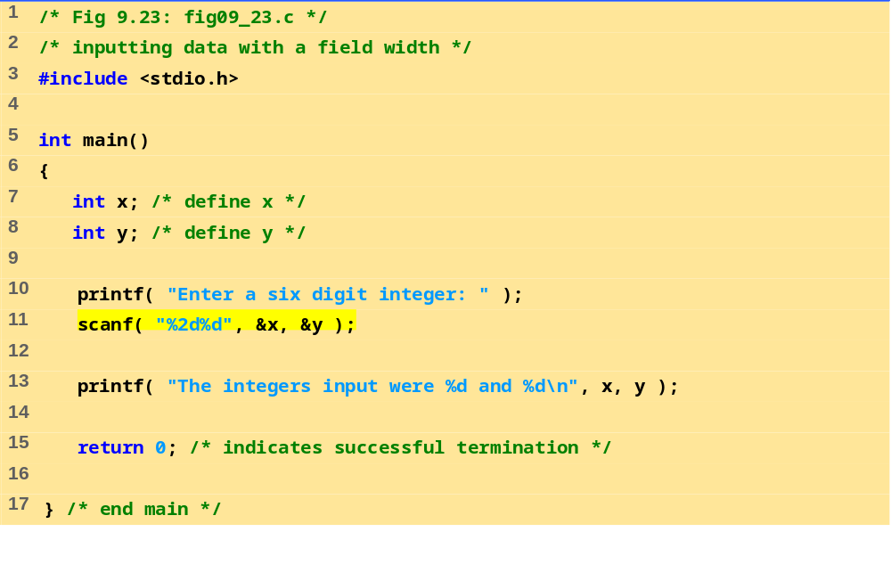
fig09_23.c
Program Output
Enter a six digit integer: 123456
The integers input were 12 and 3456

Slide 44
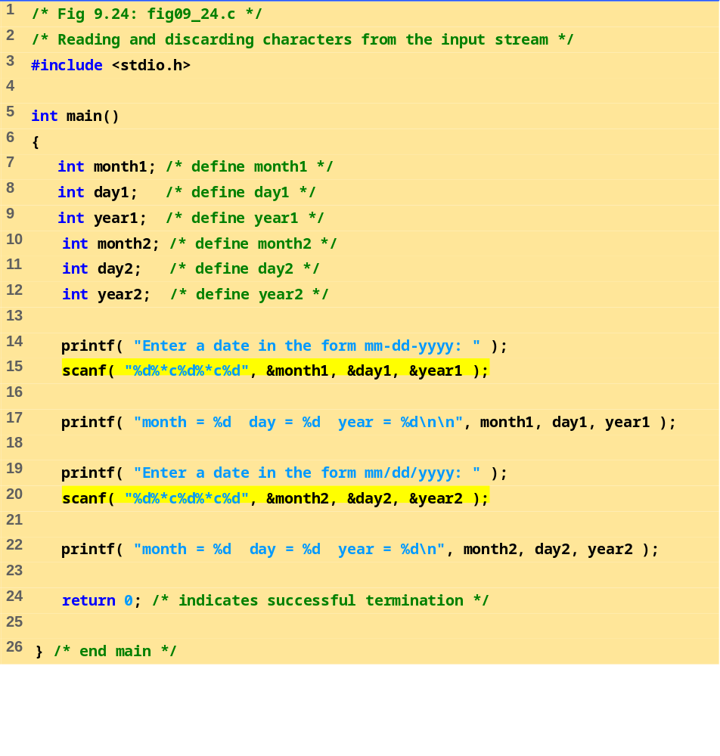
fig09_24.c

Slide 45
Enter a date in the form mm-dd-yyyy: 11-18-2003
month = 11 day = 18 year = 2003
Enter a date in the form mm/dd/yyyy: 11/18/2003
month = 11 day = 18 year = 2003
Program Output

